Slide 1
Machine Vision lecture 3

Slide 2
Edge detection
Edges are local changes in image intensity
Can be used to separate the object from the background
In one dimension a edge is associated with a local peak in the first derivate

Slide 3
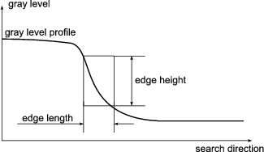

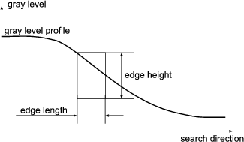

Edges in image
Search direction →
Search direction →

Slide 4
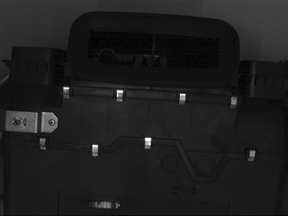
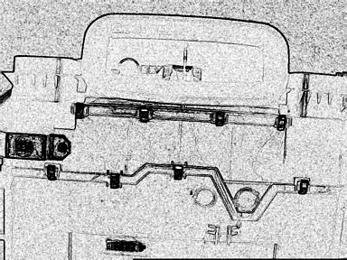
Edge filters - example
Original image
Edge image

Slide 5
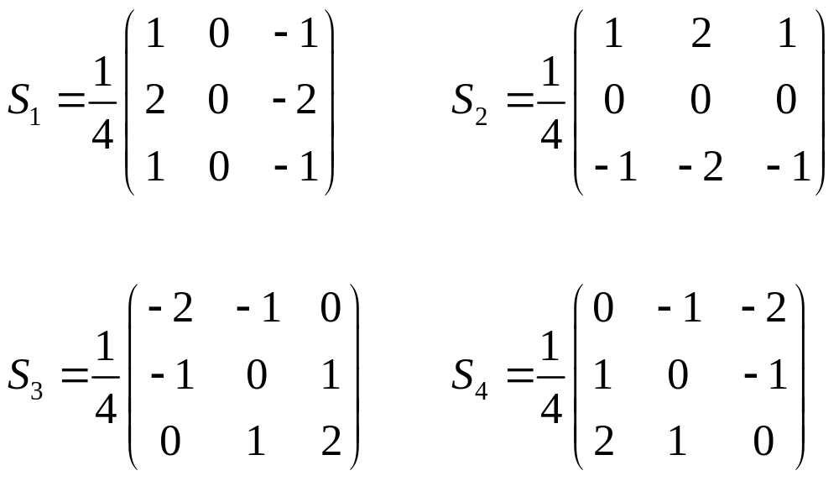
Sobel operator
One of the most common used edge detectors

Slide 6
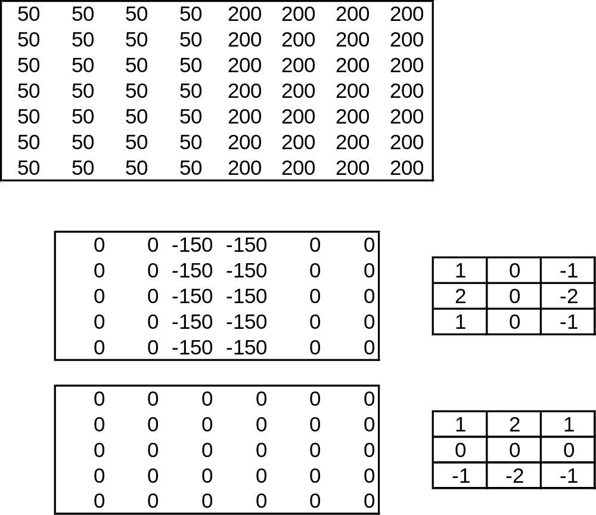
Sobel filter - example

Slide 7






Sobel filter
Original image
Horizontal
filter, S₁
Vertical
filter, S₂
Diagonal filter, left top to right bottom, S₃
Diagonal filter, right top to left bottom, S₄
Combined maximum image

Slide 8
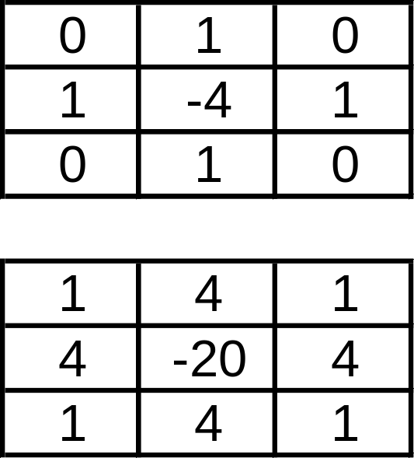

Second derivative edge filter
Laplacian
  Not frequent due to problems with noise

Slide 9
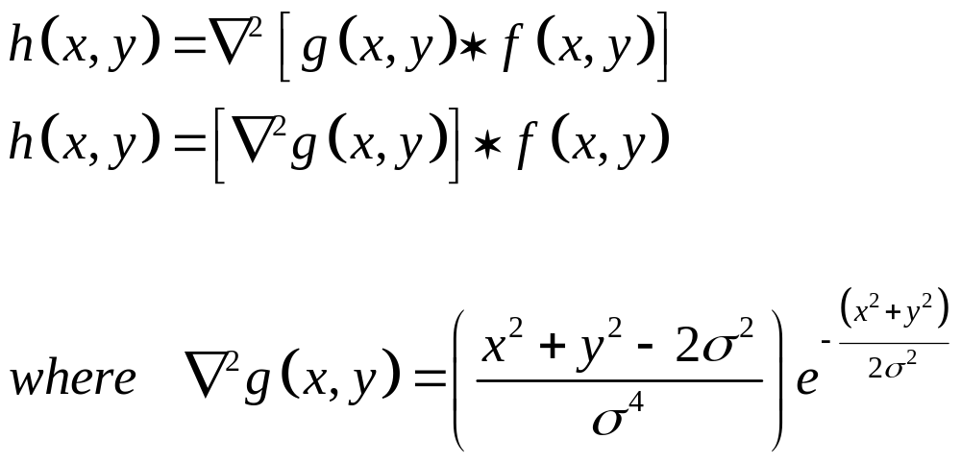
Laplacian of Gaussian (LoG)

Slide 10
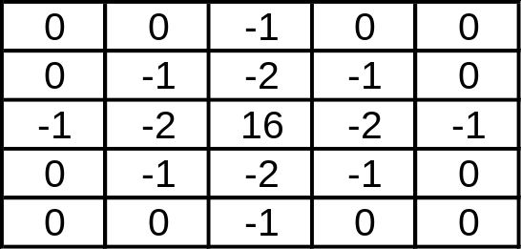
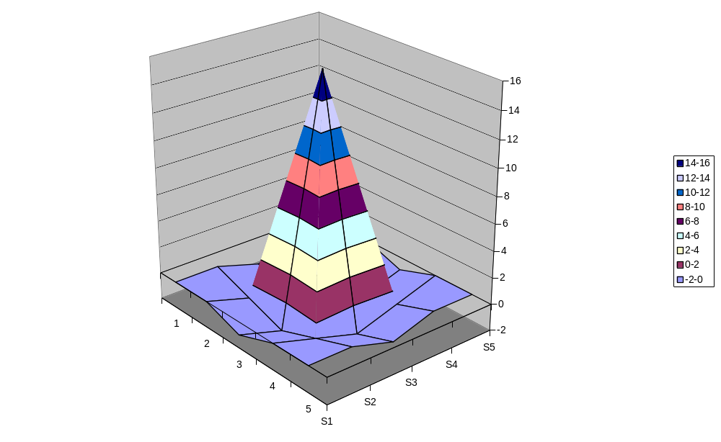
Mexican hat operator (LoG)
5x5 LoG

Slide 11
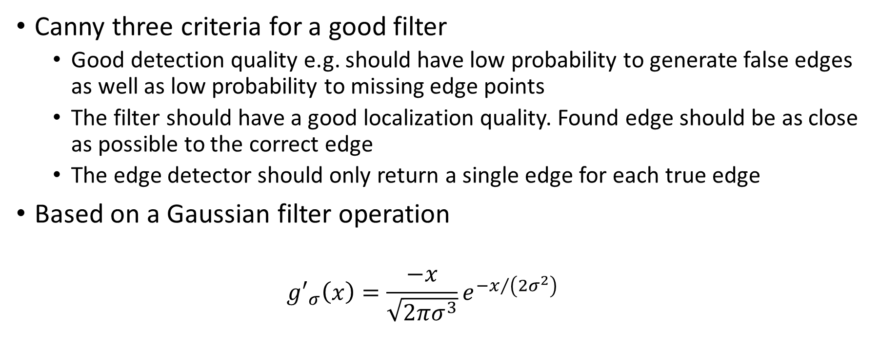
Canny edge detection
Canny three criteria for a good filter
  Good detection quality e.g. should have low probability to generate false edges as well as low probability to missing edge points
  The filter should have a good localization quality. Found edge should be as close as possible to the correct edge
  The edge detector should only return a single edge for each true edge
Based on a Gaussian filter operation
  $${g′}_{σ}\left(x\right)=\frac{−x}{\sqrt{2πσ^{3}}}e^{{−x}/{\left(2σ^{2}\right)}}$$

Slide 12
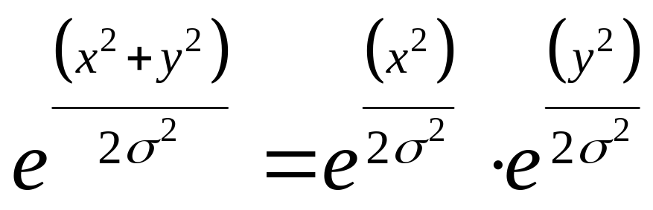
Gaussian smoothing
Advantages of Gaussian filtering
  Rotationally symmetric (for large filters)
  Filter weights decrease monotonically from central peak, giving the most weight to central peak.
  Simple and intuitive relationship between size of σ (standard derivation) and size of object whose edges will be detected in image
  The Gaussian filter is separable

Slide 13
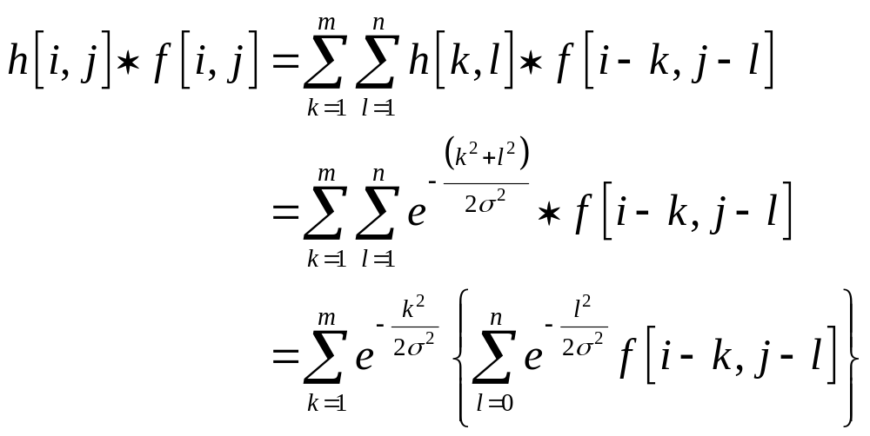
Gaussian separability
f=input image
h=Gaussian filter

Slide 14
Advantages of separability
First filter the image with one dimensional horizontal filter
Then filter the result of the first filter operation with a one dimension vertical filter
For a k*k Gaussian filter, 2D filter requires k² operations per pixel
Using separable filters, this can be reduced to 2k operations per pixel

Slide 15
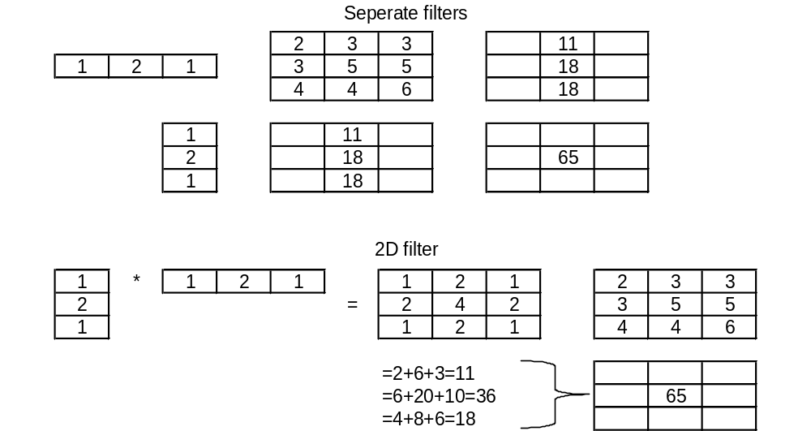
Separability

Slide 16
Advantages Gaussian
Filter of a Gaussian with itself is another Gaussian
  Filter the image with a small Gaussian
  Then filter that smoothed image with another small Gaussian and the result is equivalent to smoother the original image with a lager Gaussian
  If a image is smoothed with a Gaussian having standard derivation σ twice, then it is the same results as smoothing the image with a Gaussian having standard derivation (2σ)^{1/2}
    nxn filter and then mxm filter gives result (n+m-1)x(n+m-1)

Slide 17
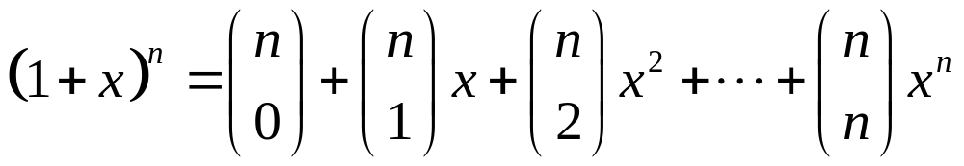
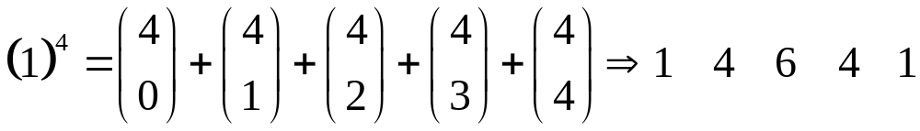
Design Gaussian filter
The Gaussian filter can be approximated using coefficients of binomial expansion:
Assume n=4,
This method can be used up to around n=10 due to coefficients are to large for most computers

Slide 18
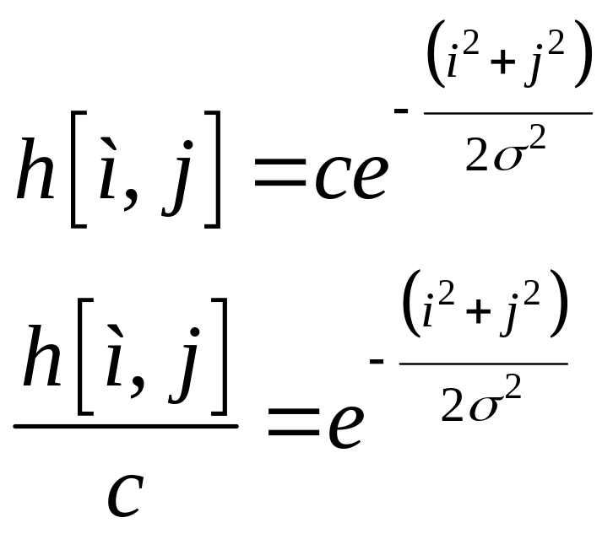
Design Gaussian filter
Another approach.
  Calculate directly from the formula
  c is the normalizing constant
  Chose value for σ² and filter size n

Slide 19
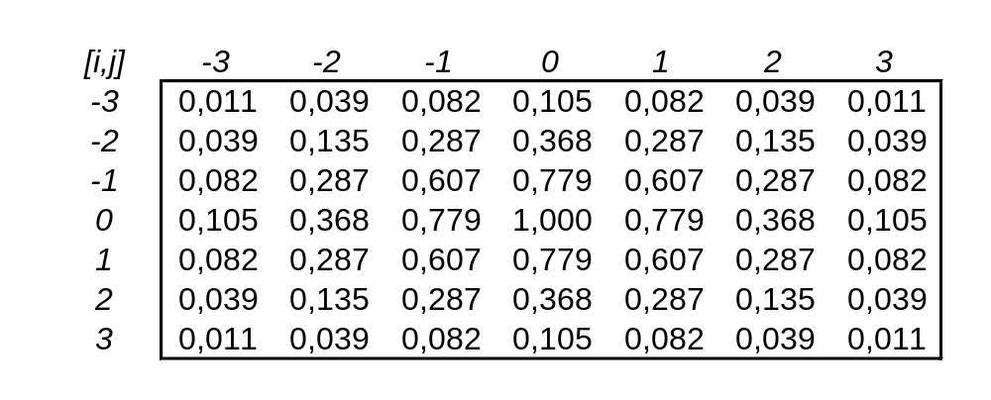
Design Gaussian filter
Assume n=7 and σ²=2

Slide 20
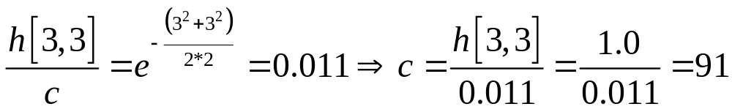
Design Gaussian filter
Desired to have filter weights as integer
  Select a corner value and calculate c such that this value becomes 1

Slide 21
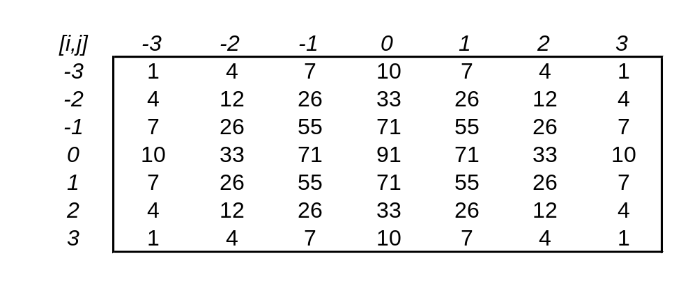
Design Gaussian filter
Final filter kernel

Slide 22
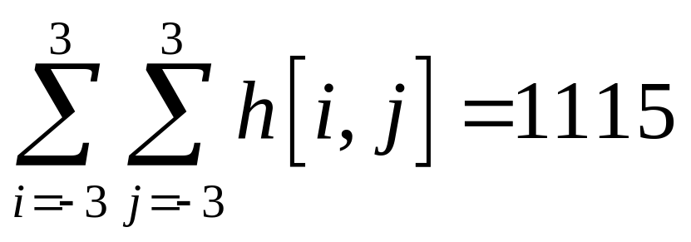
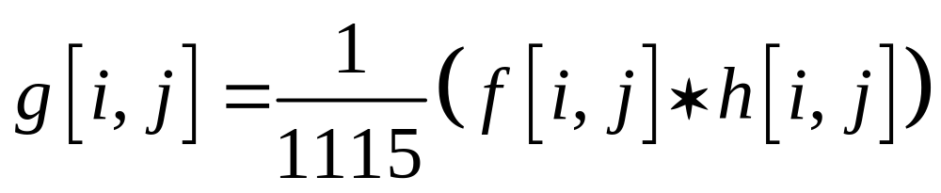
Design Gaussian filter
The filter kernel don’t sum to 1. Therefore the output pixel must be normalized
Therefore output image equal to

Slide 23
Moving window in C# and OpenCV
Filter weights
for(row = 1 ; row < image->height ; row++)
{
for(col = 1 ; col < image->widht ; col++)
{
tmp_pix = grayImgPtr[imageWidthStep * (row-1) + (col-1)] * 1 +
grayImgPtr[imageWidthStep * (row-1) + (col)] * 1 + grayImgPtr[imageWidthStep * (row-1) + (col +1)] * 1 +
grayImgPtr[imageWidthStep * (row) + (col-1)] * 1+
grayImgPtr[imageWidthStep * (row) + (col)] * 1 +
grayImgPtr[imageWidthStep * (row) + (col +1)] * 1 +
grayImgPtr[imageWidthStep * (row+1) + (col-1)] * 1 +
grayImgPtr[imageWidthStep * (row+1) + (col)] * 1 +
grayImgPtr[imageWidthStep * (row+1) + (col +1)] * 1);
tmp_pix = tmp_pix / 9;
filterImage[row * imageWidthStep + col] = tmp_pix;
}
}
Row above current pixel
Current row
Current pixel
Sum of filter weights
Row below current pixel

Slide 24
Find position and orientation of object in the image

Slide 25
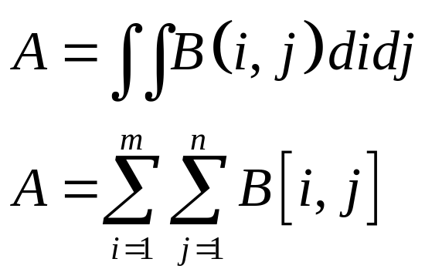
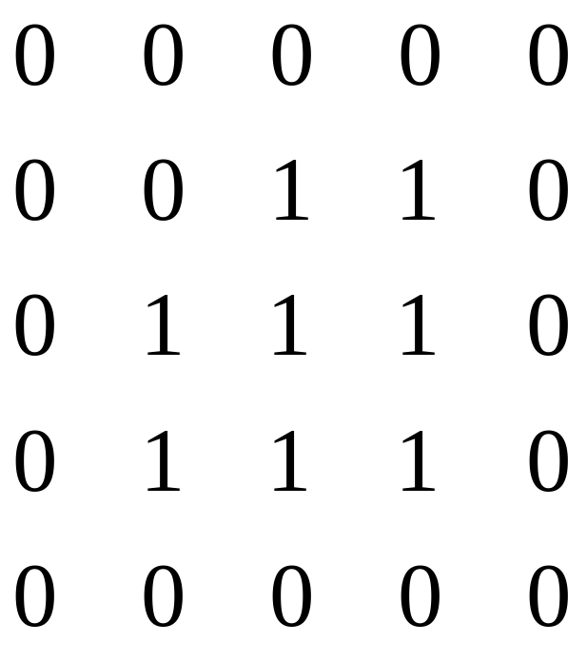
Size of object
The object size can be calculated with the zero-order moment (binary image)
A = the number of pixels ie ones (1) in the image

Slide 26
Position
Known background and distance between object and camera
Centre of area binary images is the same as centre of mass
The centre of area is relative insensitive against noise.

Slide 27
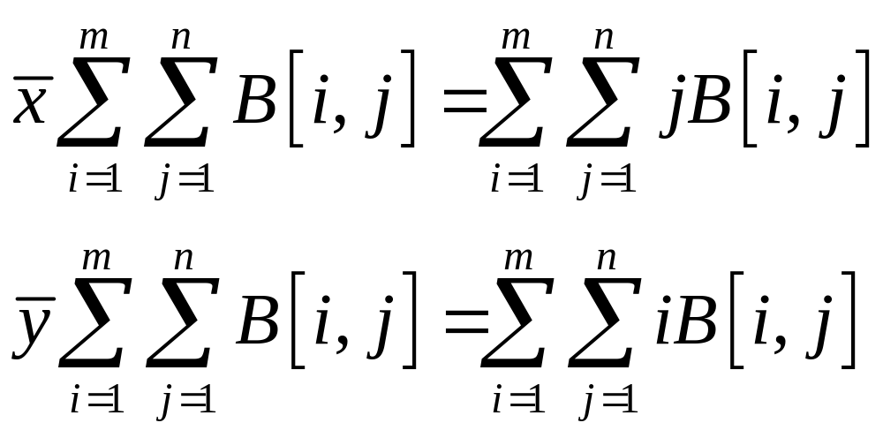


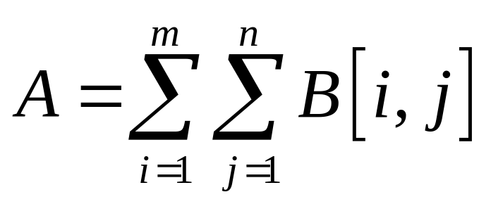
Position of object
Where and are the coordinates of the centre of the region
Remember that:

Slide 28
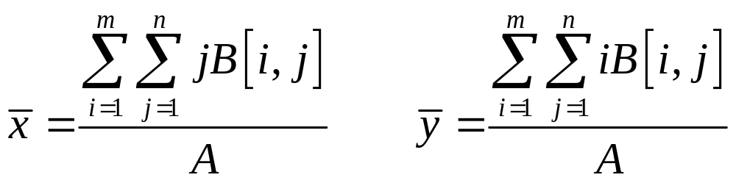
Position of object
These are the first-order moments

Slide 29
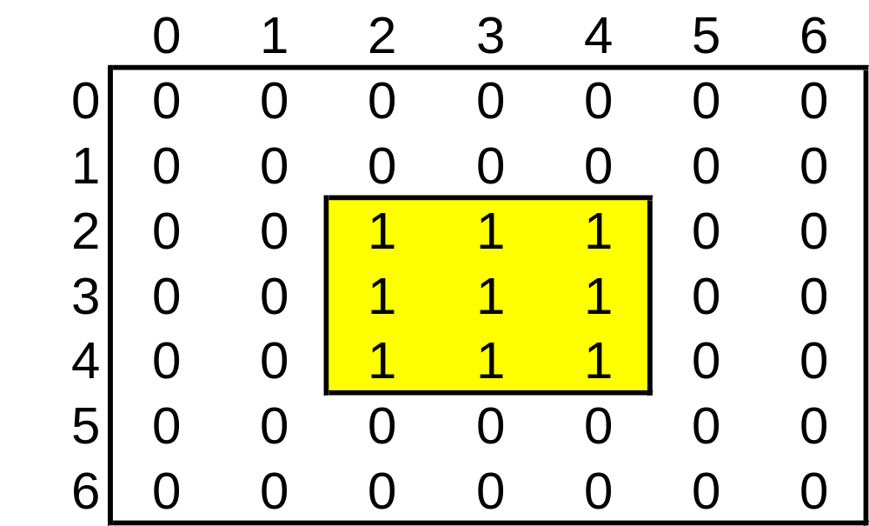
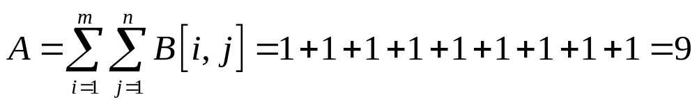
Example - position

Slide 30
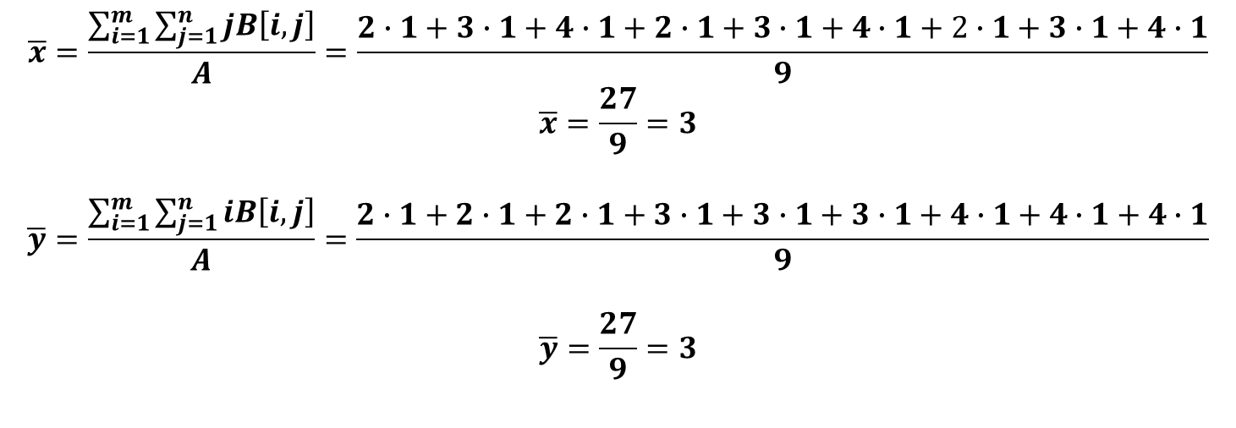
Example - position
$$\overline{x}=\frac{\sum_{i=1}^{m}{\sum_{j=1}^{n}{jB\left[i,j\right]}}}{A}=\frac{2∙1+3∙1+4∙1+2∙1+3∙1+4∙1+2∙1+3∙1+4∙1}{9}$$
$$\overline{x}=\frac{27}{9}=3$$
$$\overline{y}=\frac{\sum_{i=1}^{m}{\sum_{j=1}^{n}{iB\left[i,j\right]}}}{A}=\frac{2∙1+2∙1+2∙1+3∙1+3∙1+3∙1+4∙1+4∙1+4∙1}{9}$$
$$\overline{y}=\frac{27}{9}=3$$

Slide 31
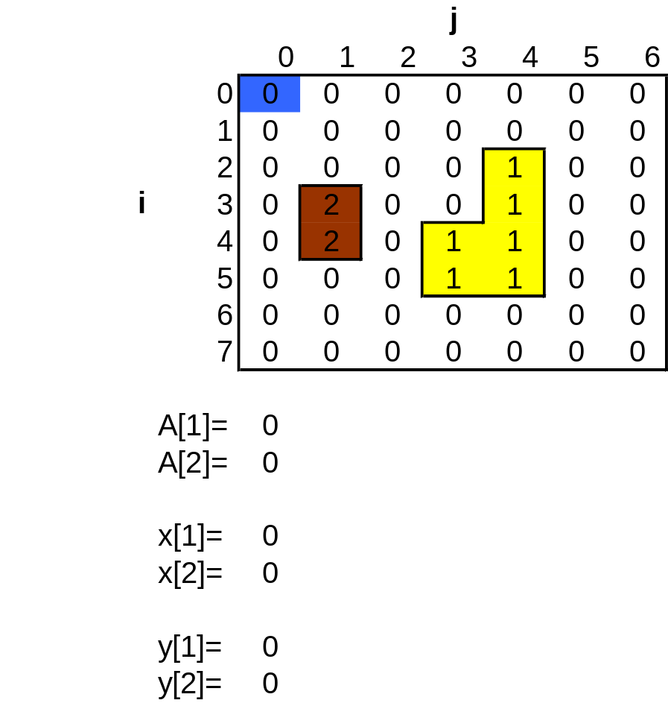
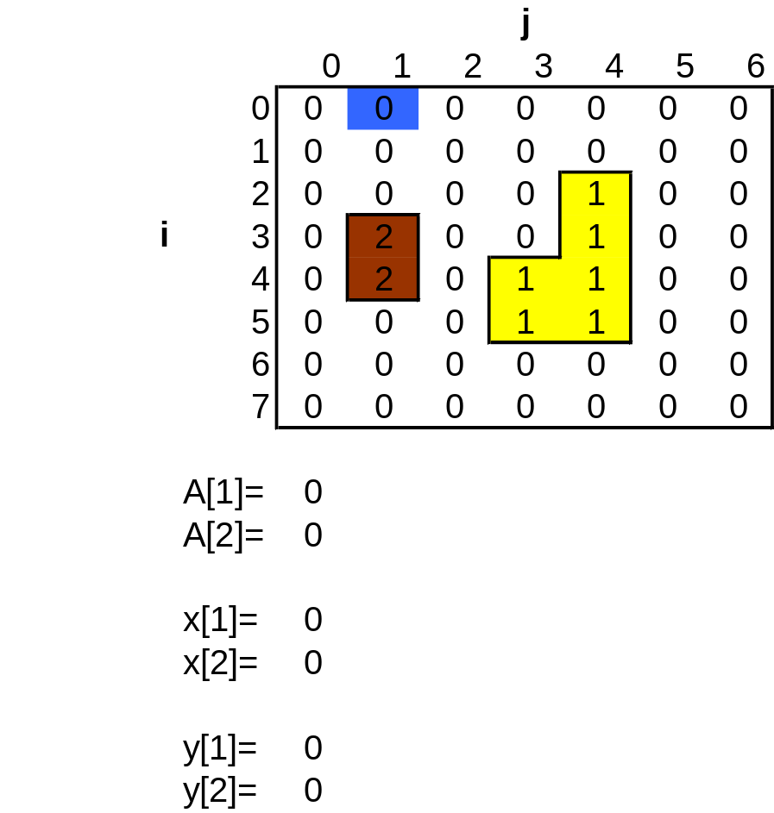
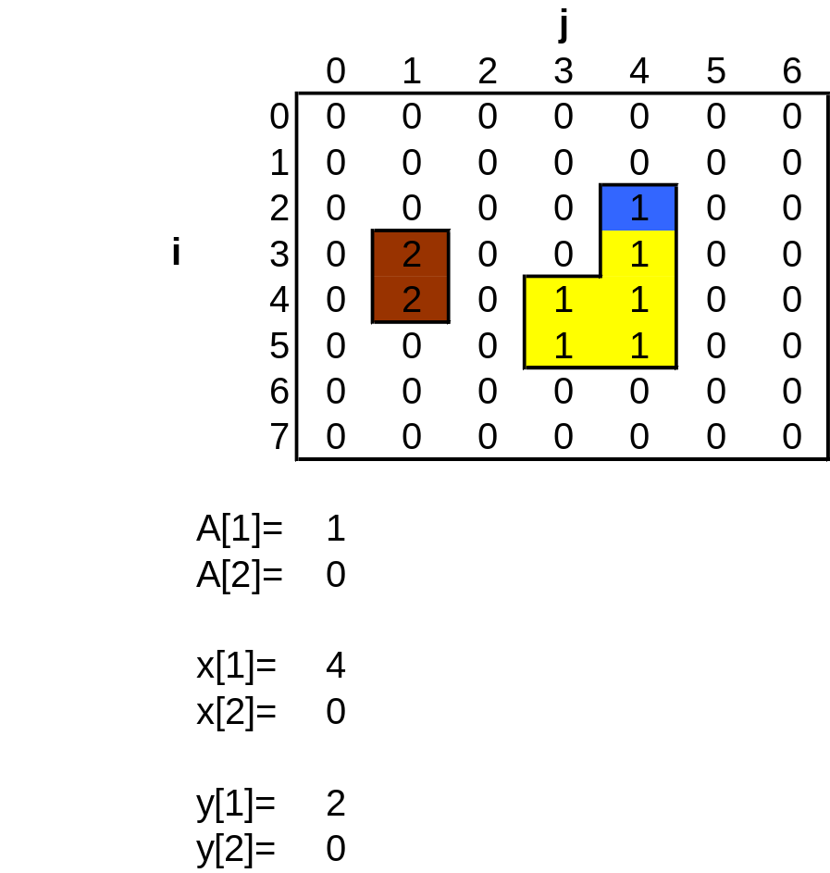
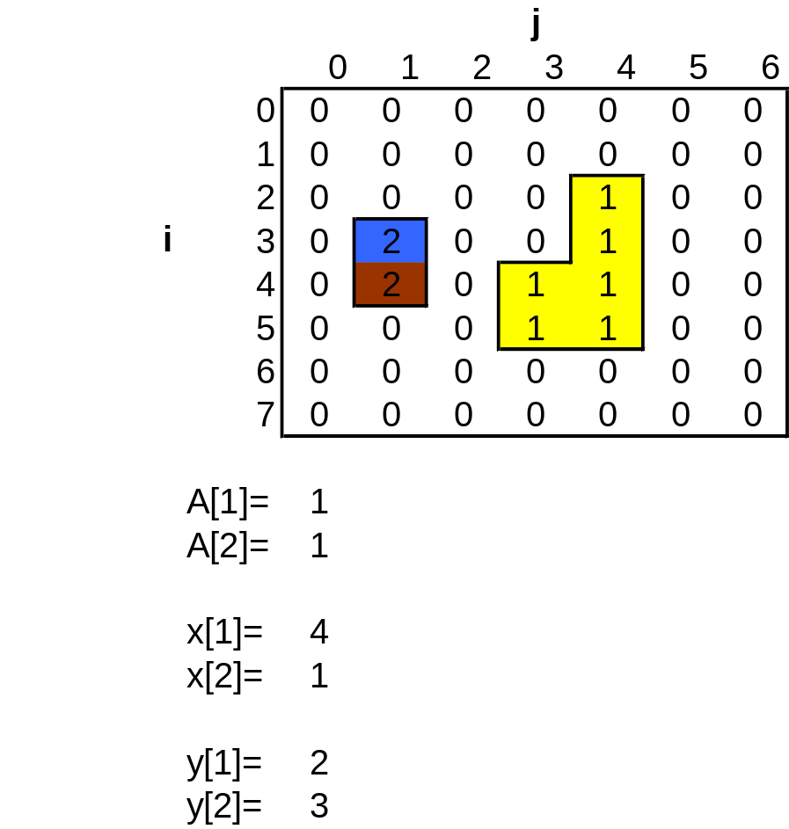
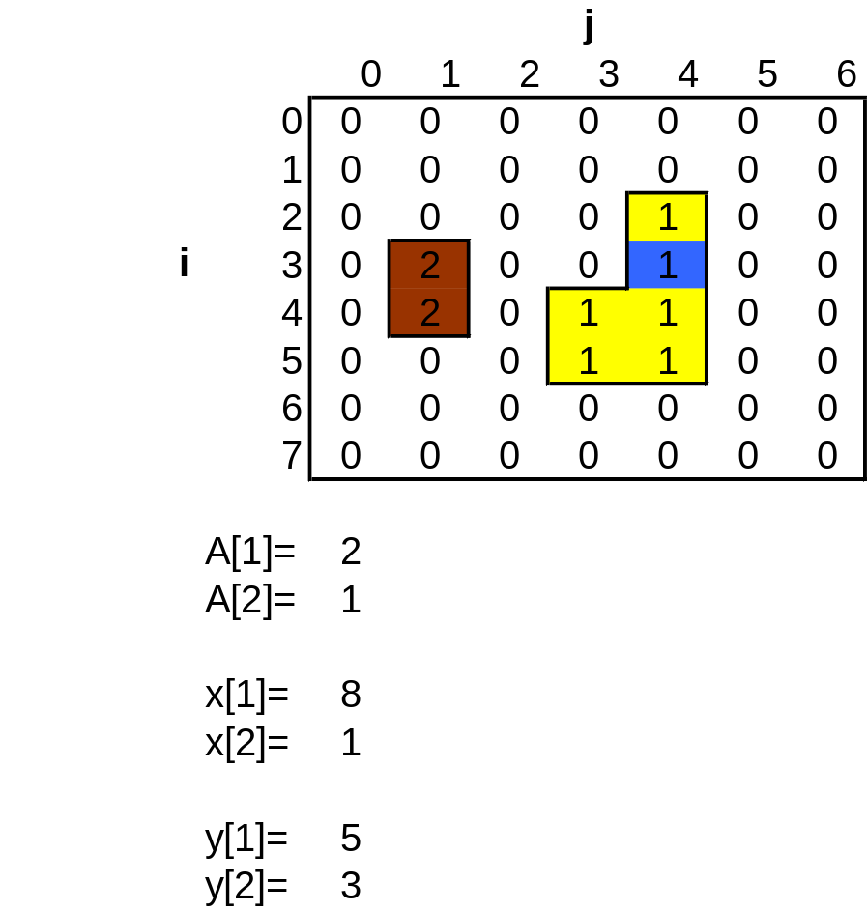
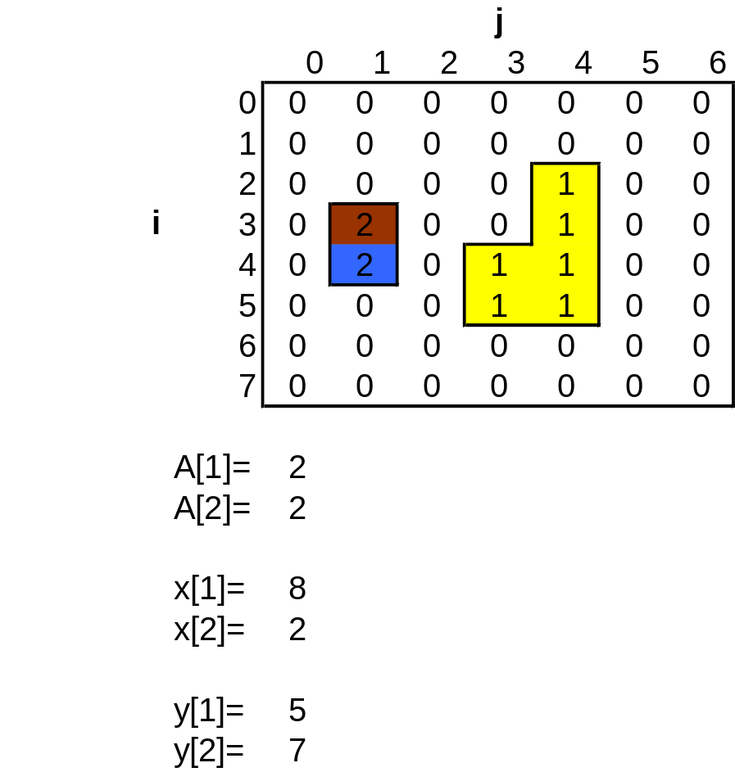
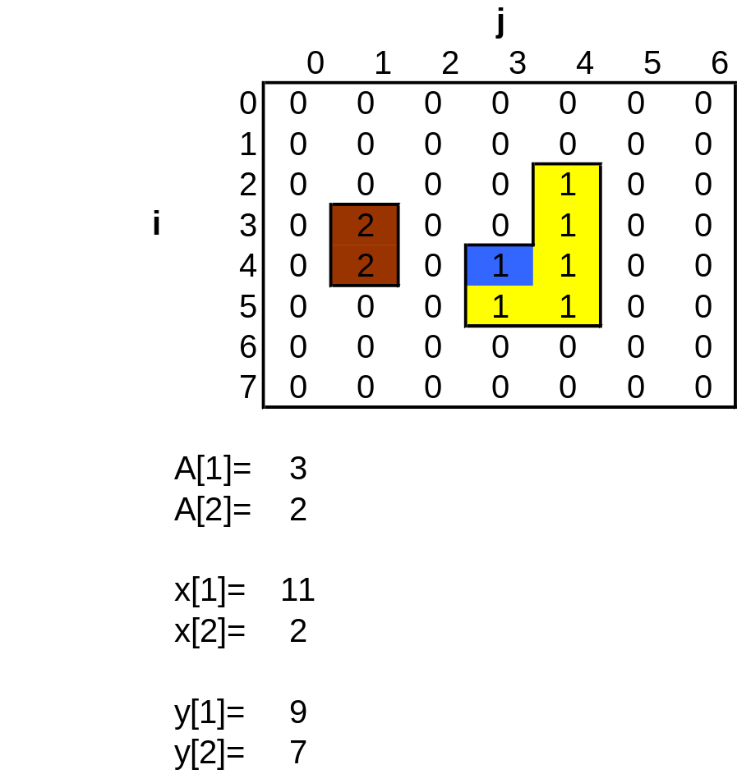
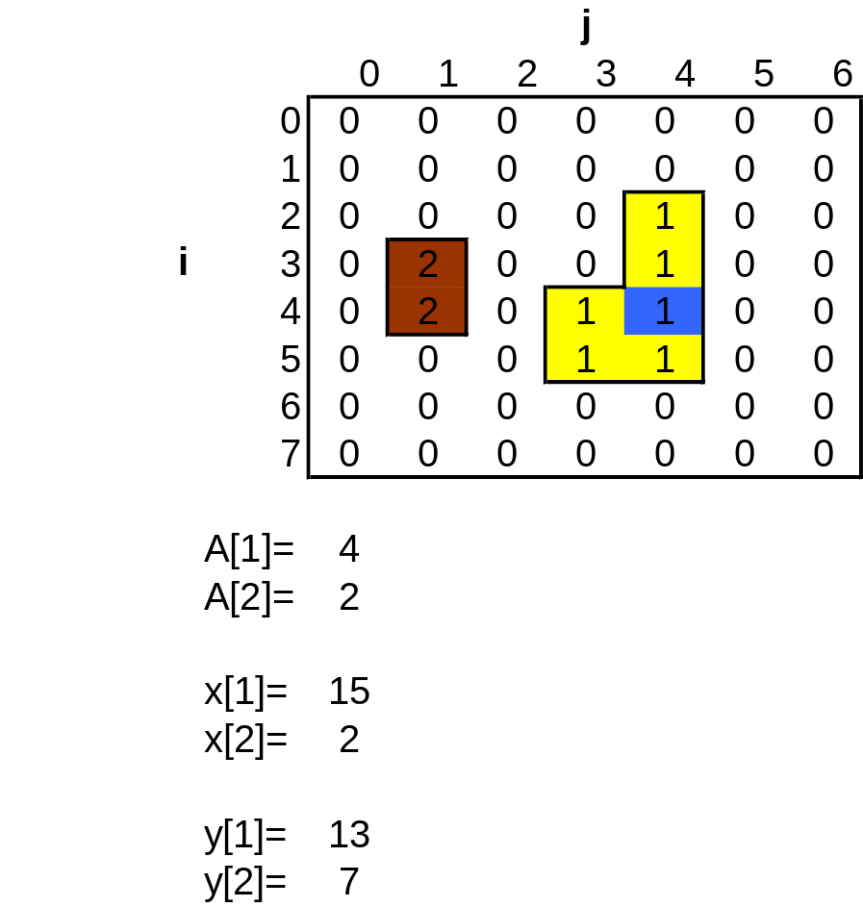
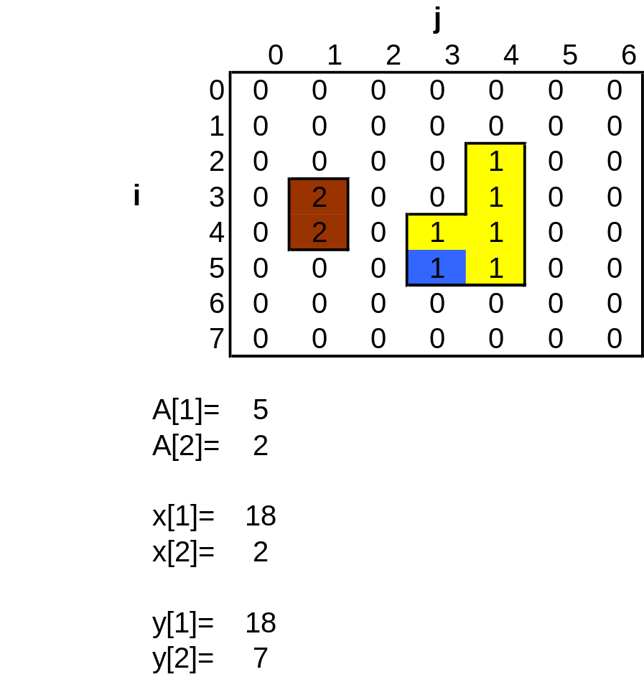
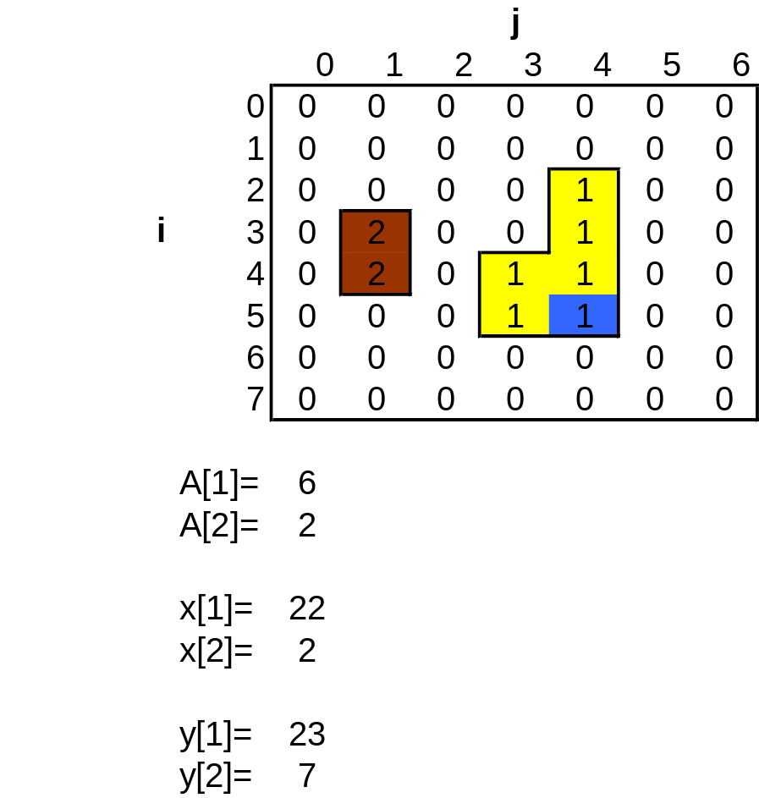
Example
Known number of components

Slide 32
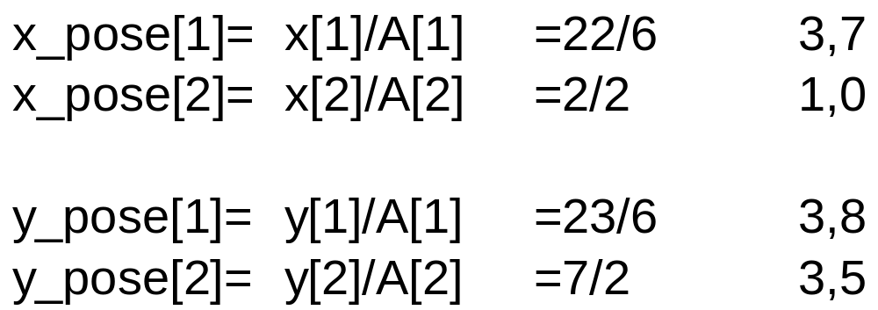
Example

Slide 33
Orientation
For some shapes (such as circles), orientation is not unique
To define unique orientation, an object must be elongated
The axis of the elongation can be used to define the orientation
The axis of least second moment (in 2D equivalent to the axis of least inertia) is used as the axis of elongation

Slide 34
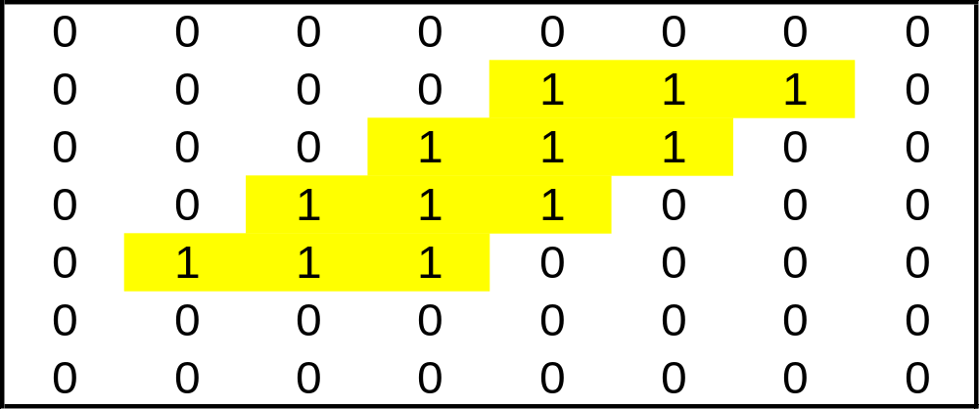
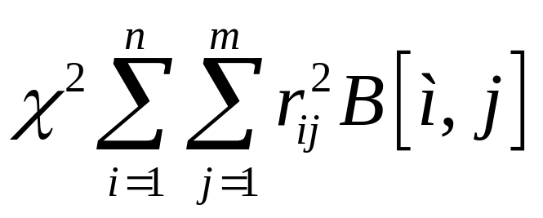
Elongation axis

Slide 35
Polar representation of a straight line
ρ=xcos(θ)+ysin(θ)
ρ
θ
x

Slide 36
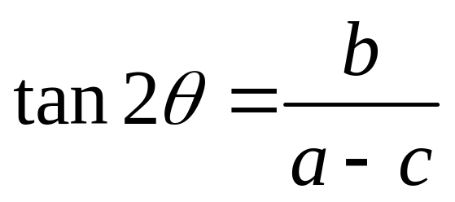
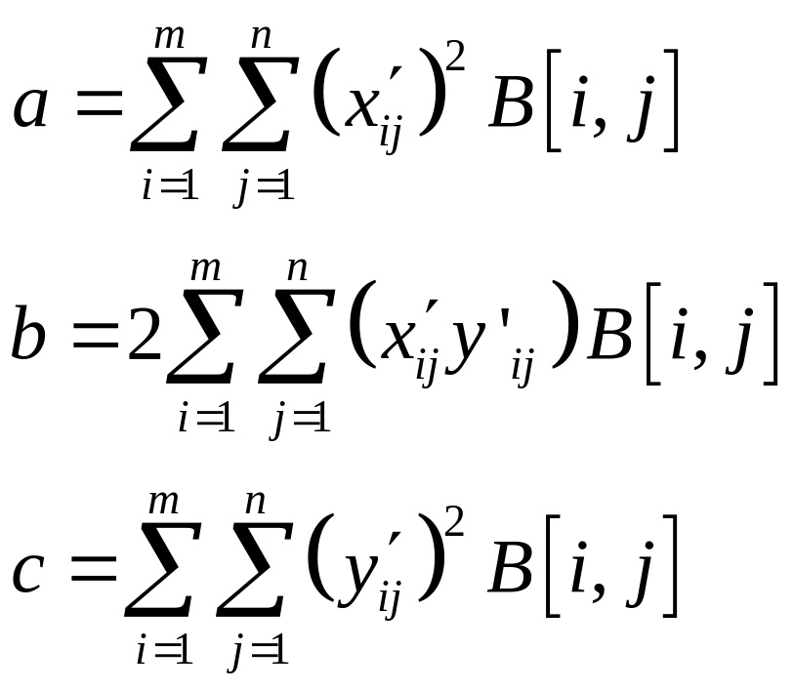
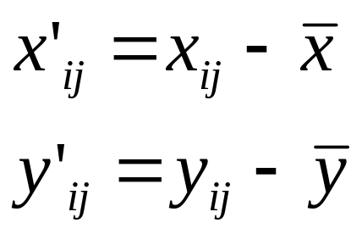
Orientation of object
Orientation
where

Slide 37
Limitations
If b = 0 and a = c, the object does not have a unique axis of orientation
The elongation E of the object is the ratio of the largest to the smallest value for X
Not that the elongation is 1 for a circle and a square

Slide 38
Example
Image starts in [1,1]

Slide 39
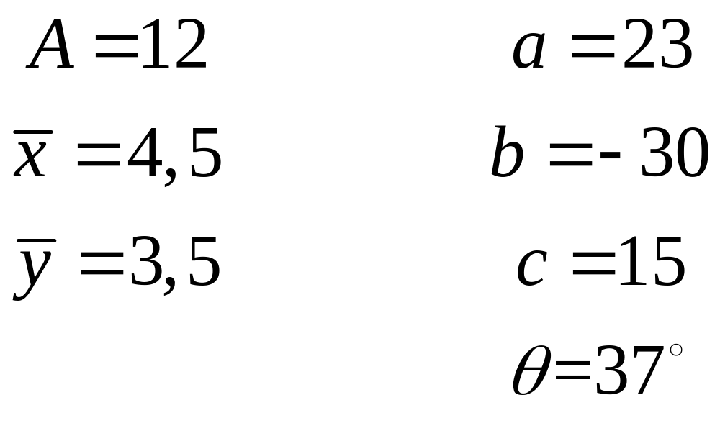
Answer

Slide 40
Find unique object in the image

Slide 41
Connect Component
Used for identification of different objects in an image if several objects exists in the image
One of the most common operations in machine vision
Are a bottleneck in the vision system due to global operation
Finds all objects and assigns a unique label

Slide 42
Connect Component
Recursive algorithm
  Inefficient on sequential processors
  Commonly used on parallel machines
Sequential algorithm
  Requires two passes over the image
  Look at the neighbour to the left and above
  Assign a unique label to each new object
  Store information about unique labels in a table
  First run assign unique labels to objects
  Second run, one label are assigned to all pixels in the object

Slide 43
Connect Component - algorithm
Scan the image left to right, top to bottom
If the pixel is 1 then
  If only one of its upper and left neighbours has a label, then copy the label
  If both has the same label, copy the label
  If both have different labels, then copy the upper’s label and enter the label in the equivalence table as equivalent labels
  Otherwise assign a new label to this pixel and enter this label in the equivalent table

Slide 44
Connect Component - algorithm
If there are more pixels to consider, the go to step 2
Find the lowest label for each equivalent set in the equivalence table
Scan the picture. Replace each label by the lowest label in its equivalent set

Slide 45
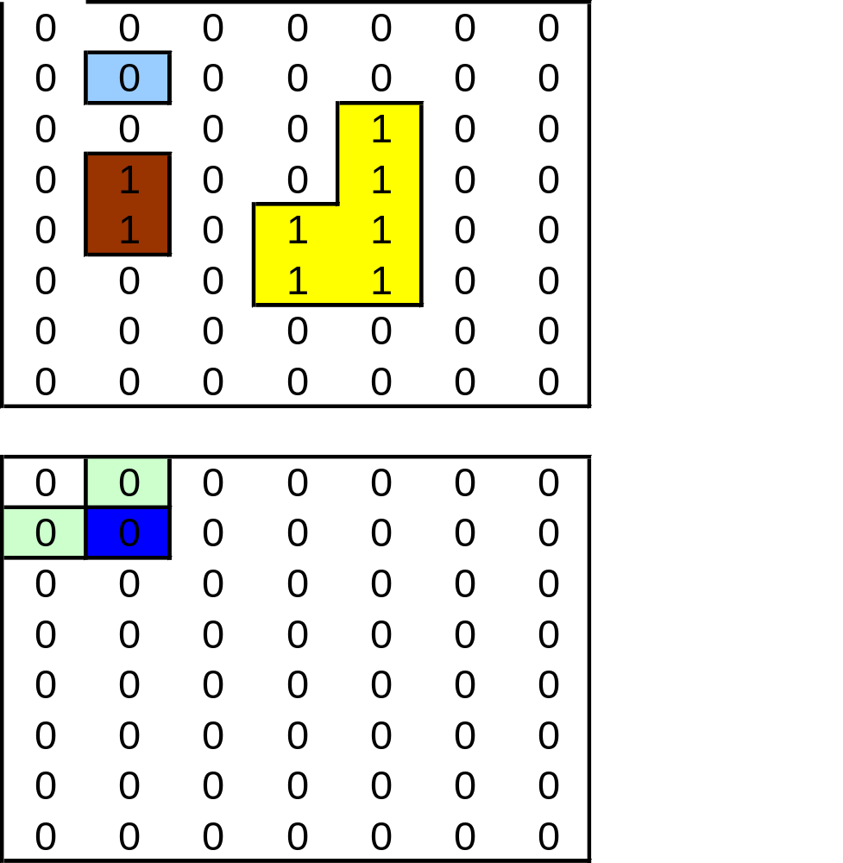
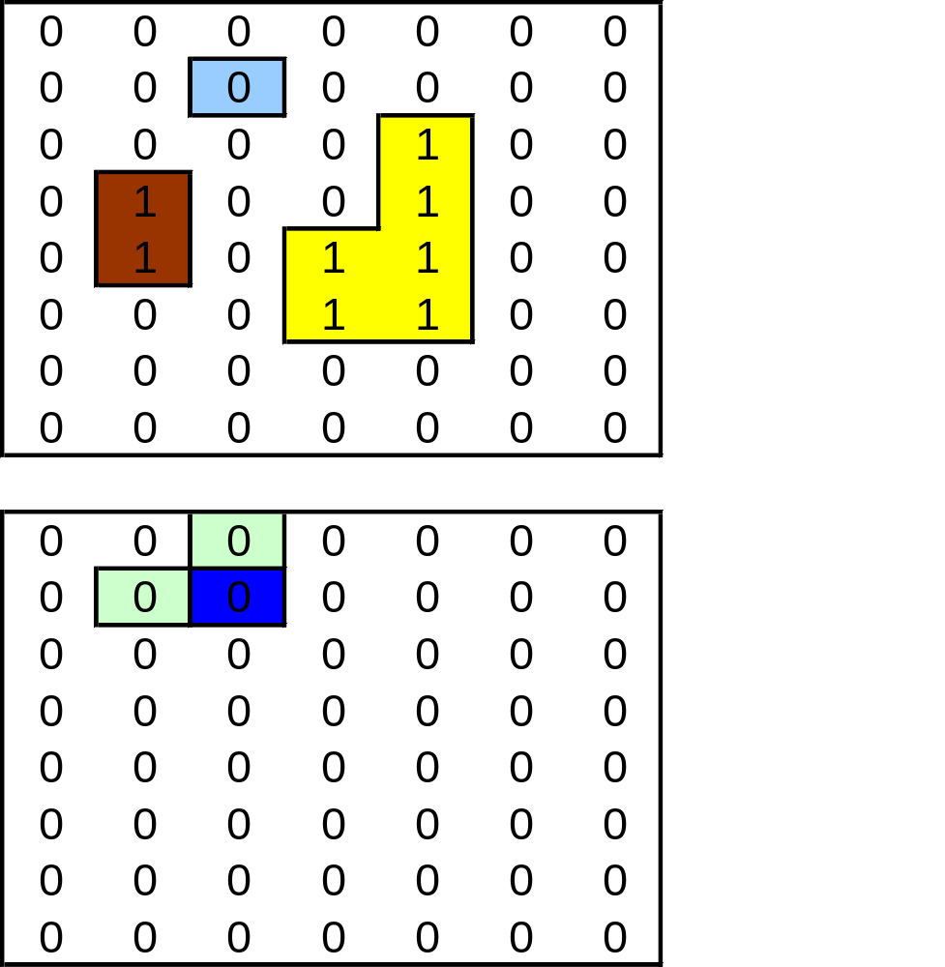
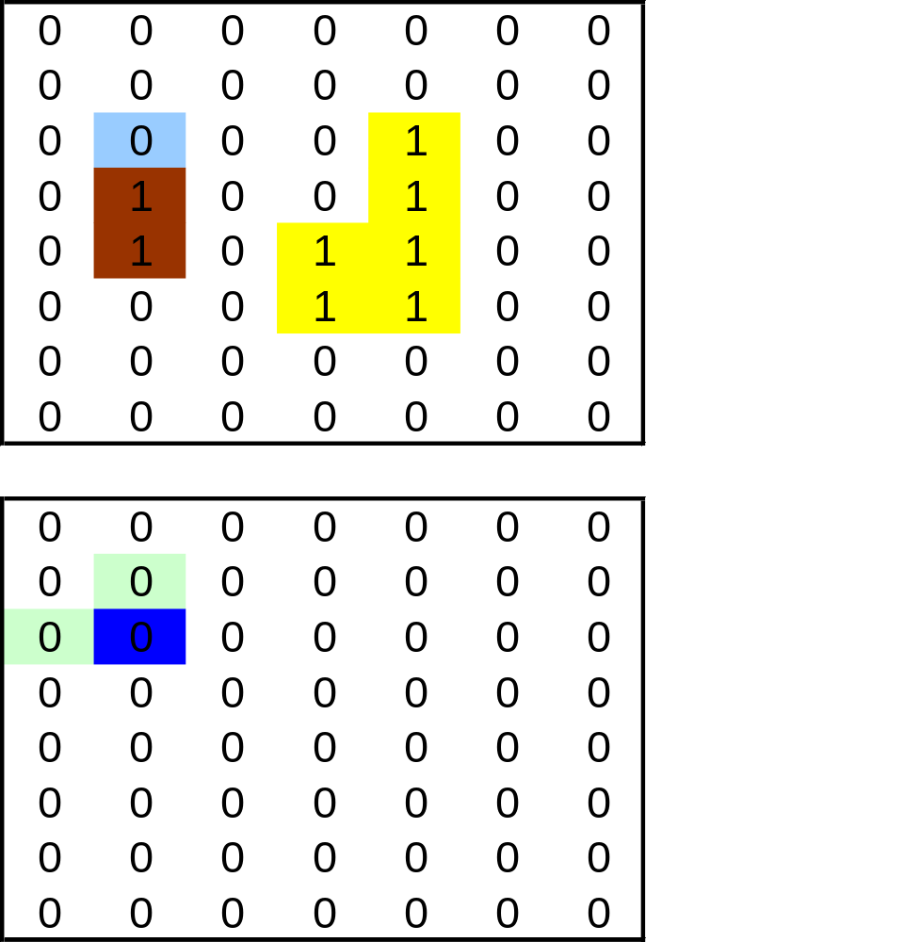










Table
Input image
Output image

Slide 46

Connected component example

Slide 47


After step 3

Slide 48


Final coding

Slide 49
Memory allocation
Memory must be allocated for temporary arrays due to unknown image size
  unsigned int *obj_code;
  if ((obj_code=(unsigned int *) malloc(h*w*
  sizeof(unsigned int)))==NULL)
  {
  printf("Not enough memory to allocate buffer\n");
  return; /* terminate program if out of memory */
  }
Don’t forget to free the memory
  free(obj_code);

Slide 50
Correspondence list correction
for (i=1; i<=nb; i++)
{
k=i;
if (corresp[k]!=k)
{
k=corresp[k];
corresp[i]=corresp[k];
ne=ne+1;
}
}
corresp= correspond list
i counter
k counter
nb number of objects
ne corrected number of objects

Slide 51
Final coding
Run through the object code image
for (i=1; i<height-1; i++)
{
for(j=1; j<width-1; j++)
{
if (obj_code[width*i+j]!=0)
{
c=obj_code[width*i+j];
obj_code[width*i+j]=corresp[c];
}
}
}

